Slide 1
Decentralized Crowdfunding Platform
Presented By :-
Snehil Gupta
1801013074
IT - 6th Sem
2) Saumya Shukla
1801013058
IT - 6th Sem
Mentors :-
Mr. Prashant Soni
Mr. Bhanu Pratap Rai
Dr. Vijay Dwivedi

Slide 2
Introduction
Kickstarter’s idea :-
Kickstarter is an American crowdfunding application, where creator can put up his idea and in return receive fund.
At first, the project creator will put up his idea on this application along with its requirements.
Upon liking the idea, the investors can fund the project in terms of cost and maintenance required for the project.
The project creator will choose a deadline and minimum funding goal.
If the goal is not met by the deadline, no fund are collected

Slide 3
Disadvantages of such idea :-
In case of kickstarter, the data is stored in a normal database which is mutable in nature.
So, some of the issues for this kind of service is that :-
People who post the project will deliver on their project or not.
The creator can even do some fraudulent activity such as running away with the fund.
Either the completed project will meet the funder’s expectations or not.
Notes:
hat the completed projects will meet backers' expectations.

Slide 4
Our Aim
Our main aim for this project is to help the funders to avoid any kind of fraudulent risks that were mentioned before.
For this, we will use Ethereum blockchain in place of a normal database to make sure the application is immutable and tamper-free.
The fund will only be get transacted permanently only if the project is delivered to the investors properly.

Slide 5
Objectives
To implement a decentralized application based on crowdfunding.
To use a front-end framework in order to interact with the application.
To allow the fund raisers to fund a project by sending ether to the e-wallet of the project creator.
To test the application before deploying it into the main ethereum blockchain network.
For future scope, we’ll add a functionality for investors to report the person if he attempts to fraud.

Slide 6
Major Modules
Module 1 : Information gathering / planning
Module 2 : UI/UX design
Module 3 : Content writing
Module 4 : Front-end design and development
Module 5 : Back-end / Blockchain Connectivity
Module 6 : Testing / Review

Slide 7
Tools & Technology
UI/UX design :
Balsamiq wireframes
Adobe XD
Front-end framework :
React
React Router
Next.js
Back-end :
Ethereum Blockchain
Solidity ( for creating smart contracts)
Testing :
Mocha test framework
Ganache ( for local test network)

Slide 8
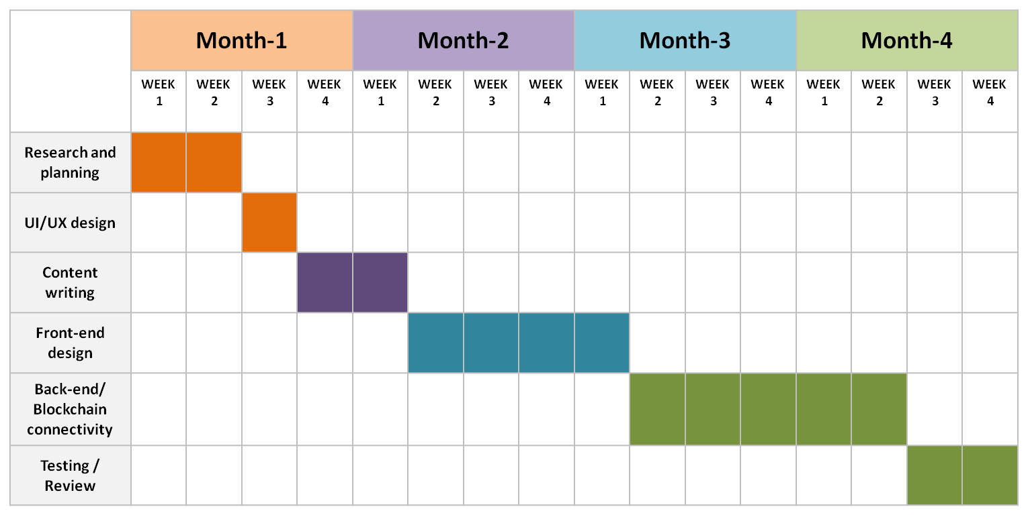
Gantt Chart

Slide 9
Thank You

